Slide 1
18-447
Computer Architecture
Lecture 5: Intro to Microarchitecture: Single-Cycle
Prof. Onur Mutlu
Carnegie Mellon University
Spring 2015, 1/26/2015

Slide 2
Agenda for Today & Next Few Lectures
Start Microarchitecture
Single-cycle Microarchitectures
Multi-cycle Microarchitectures
Microprogrammed Microarchitectures
Pipelining
Issues in Pipelining: Control & Data Dependence Handling, State Maintenance and Recovery, …

Slide 3
Recap of Two Weeks and Last Lecture
Computer Architecture Today and Basics (Lectures 1 & 2)
Fundamental Concepts (Lecture 3)
ISA basics and tradeoffs (Lectures 3 & 4)
Last Lecture: ISA tradeoffs continued + MIPS ISA
  Instruction length
  Uniform vs. non-uniform decode
  Number of registers
  Addressing modes
  Aligned vs. unaligned access
  RISC vs. CISC properties
  MIPS ISA Overview

Slide 4
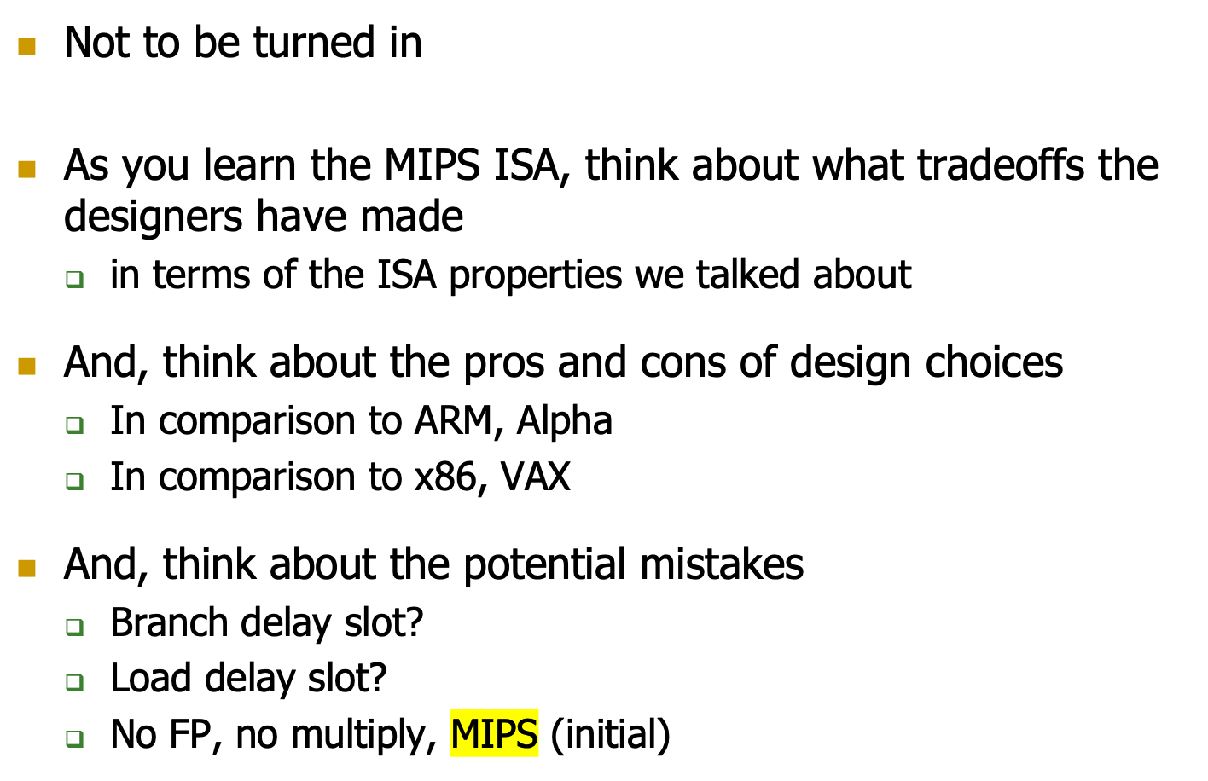
Assignment for You
Look Backward
Microprocessor without Interlocked Pipelined Stages
The hardware doesn’t do anything to detect the dependency between instructions, everything is handled by the software, so that you can design a microprocessor that is simple

Slide 5
Food for Thought for You
How would you design a new ISA?
Where would you place it?
What design choices would you make in terms of ISA properties?
What would be the first question you ask in this process?
  “What is my design point?”
Look Forward & Up

Slide 6
Review: Other Example ISA-level Tradeoffs
Condition codes vs. not
VLIW vs. single instruction
SIMD (single instruction multiple data) vs. SISD
Precise vs. imprecise exceptions
Virtual memory vs. not
Unaligned access vs. not
Hardware interlocks vs. software-guaranteed interlocking
Software vs. hardware managed page fault handling
Cache coherence (hardware vs. software)
…
Think Programmer vs. (Micro)architect

Slide 7
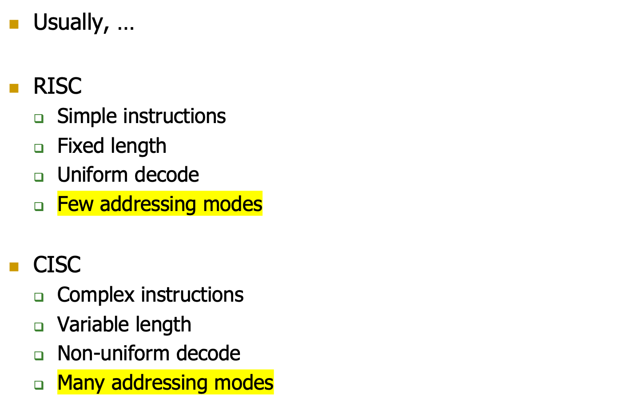
Review: A Note on RISC vs. CISC
Power

Slide 8
Now That We Have an ISA
How do we implement it?
i.e., how do we design a system that obeys the hardware/software interface?
Aside: “System” can be solely hardware or a combination of hardware and software
  Remember “Translation of ISAs”
  A virtual ISA can be converted by “software” into an implementation ISA
We will assume “hardware” for most lectures

Slide 9
Implementing the ISA: Microarchitecture Basics

Slide 10
How Does a Machine Process Instructions?
What does processing an instruction mean?
Remember the von Neumann model
AS = Architectural (programmer visible) state before an instruction is processed
Process instruction
AS’ = Architectural (programmer visible) state after an instruction is processed
Processing an instruction: Transforming AS to AS’ according to the ISA specification of the instruction
The programmer see nothing intermediate

Slide 11
The “Process instruction” Step
ISA specifies abstractly what AS’ should be, given an instruction and AS
  It defines an abstract finite state machine where
    State = programmer-visible state
    Next-state logic = instruction execution specification
  From ISA point of view, there are no “intermediate states” between AS and AS’ during instruction execution
    One state transition per instruction
Microarchitecture implements how AS is transformed to AS’
  There are many choices in implementation
  We can have programmer-invisible state to optimize the speed of instruction execution: multiple state transitions per instruction
    Choice 1: AS → AS’ (transform AS to AS’ in a single clock cycle)
    Choice 2: AS → AS+MS1 → AS+MS2 → AS+MS3 → AS’ (take multiple clock cycles to transform AS to AS’)
Microarchitecture State

Slide 12
A Very Basic Instruction Processing Engine
Each instruction takes a single clock cycle to execute
Only combinational logic is used to implement instruction execution
  No intermediate, programmer-invisible state updates
AS = Architectural (programmer visible) state
at the beginning of a clock cycle
Process instruction in one clock cycle
AS’ = Architectural (programmer visible) state
at the end of a clock cycle

Slide 13
A Very Basic Instruction Processing Engine
Single-cycle machine
What is the clock cycle time determined by?
What is the critical path of the combinational logic determined by?
AS’
AS
Sequential
Logic
(State)
Combinational
Logic
The longest instruction to process

Slide 14

Remember: Programmer Visible (Architectural) State
M[0]
M[1]
M[2]
M[3]
Registers
- given special names in the ISA
(as opposed to addresses)
- general vs. special purpose
M[4]
M[N-1]
Memory
array of storage locations
indexed by an address
Program Counter
memory address
of the current instruction
Instructions (and programs) specify how to transform
the values of programmer visible state

Slide 15
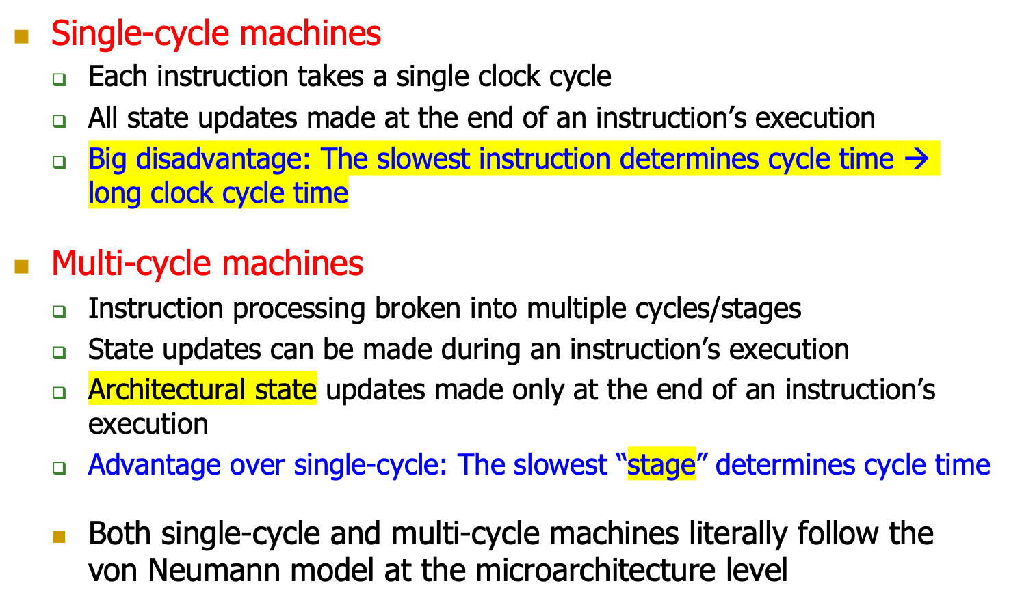
Single-cycle vs. Multi-cycle Machines

Slide 16
Instruction Processing “Cycle”
Instructions are processed under the direction of a “control unit” step by step.
Instruction cycle: Sequence of steps to process an instruction
Fundamentally, there are six phases:
Fetch
Decode
Evaluate Address
Fetch Operands
Execute
Store Result
Not all instructions require all six stages (see P&P Ch. 4)

Slide 17
Instruction Processing “Cycle” vs. Machine Clock Cycle
Single-cycle machine:
  All six phases of the instruction processing cycle take a single machine clock cycle to complete
Multi-cycle machine:
  All six phases of the instruction processing cycle can take multiple machine clock cycles to complete
  In fact, each phase can take multiple clock cycles to complete

Slide 18
Instruction Processing Viewed Another Way
Instructions transform Data (AS) to Data’ (AS’)
This transformation is done by functional units
  Units that “operate” on data
These units need to be told what to do to the data
An instruction processing engine consists of two components
  Datapath: Consists of hardware elements that deal with and transform data signals
    functional units that operate on data
    hardware structures (e.g. wires and muxes) that enable the flow of data into the functional units and registers
    storage units that store data (e.g., registers)
  Control logic: Consists of hardware elements that determine control signals, i.e., signals that specify what the datapath elements should do to the data

Slide 19
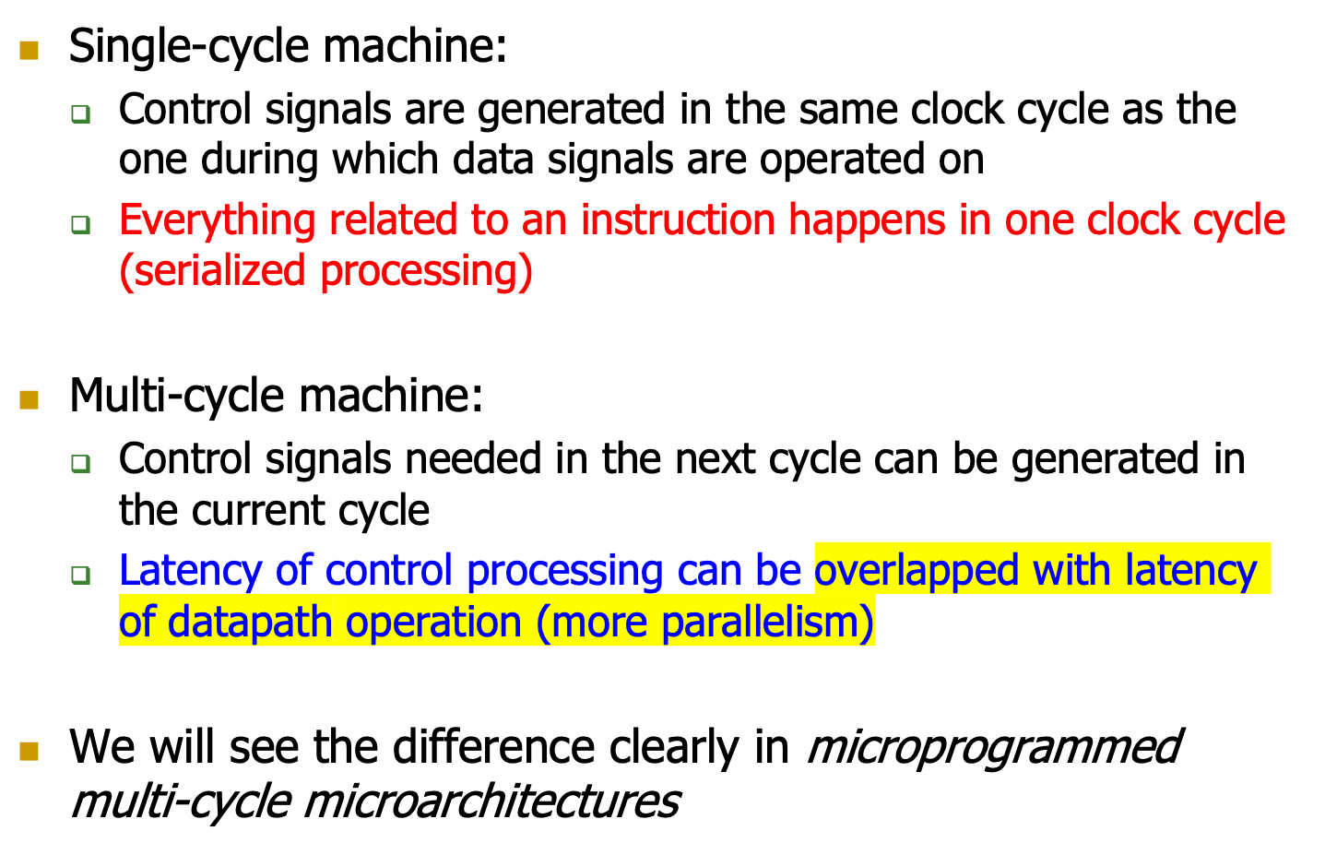
Single-cycle vs. Multi-cycle: Control & Data

Slide 20
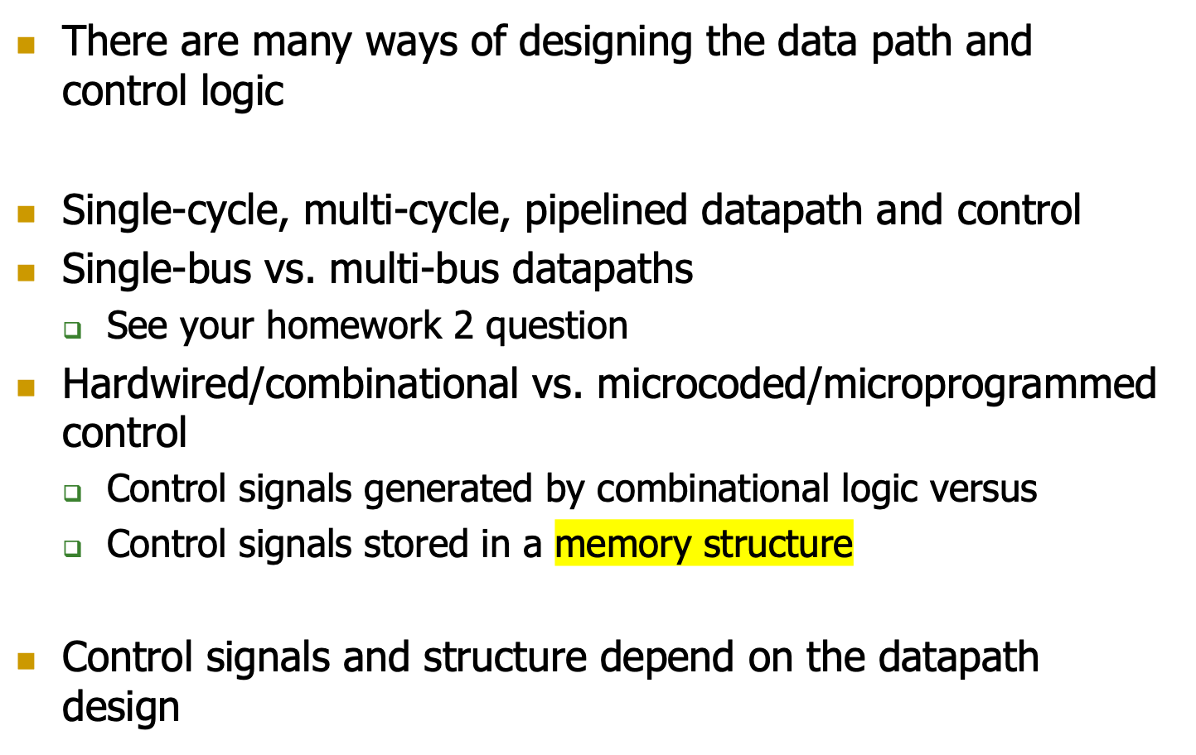

Many Ways of Datapath and Control Design

Slide 21
Flash-Forward: Performance Analysis
Execution time of an instruction
  {CPI} x {clock cycle time}
Execution time of a program
  Sum over all instructions [{CPI} x {clock cycle time}]
  {# of instructions} x {Average CPI} x {clock cycle time}
Single cycle microarchitecture performance
  CPI = 1
  Clock cycle time = long
Multi-cycle microarchitecture performance
  CPI = different for each instruction
    Average CPI → hopefully small
  Clock cycle time = short
Cycle per instruction
Now, we have
two degrees of freedom
to optimize independently

Slide 22
A Single-Cycle Microarchitecture
A Closer Look

Slide 23
Remember…
Single-cycle machine
AS’
AS
Sequential
Logic
(State)
Combinational
Logic

Slide 24
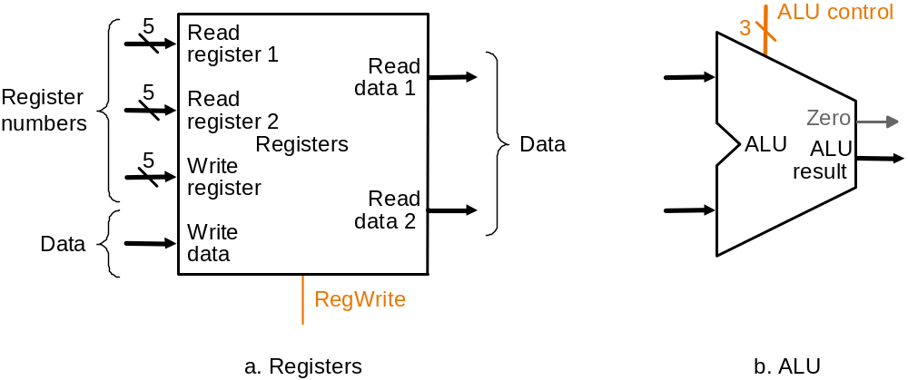
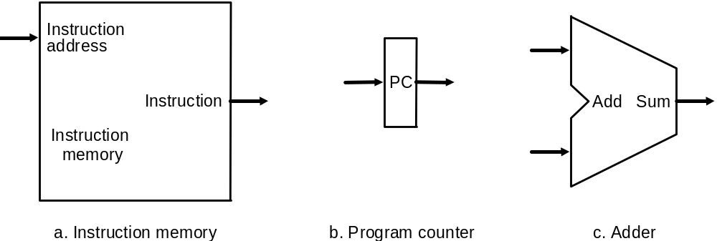
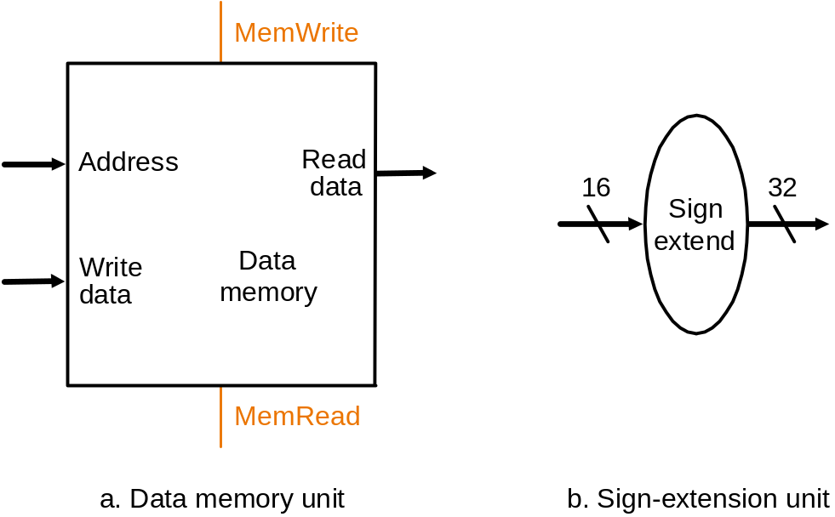
Let’s Start with the State Elements
Data and control inputs
**Based on original figure from [P&H CO&D, COPYRIGHT 2004 Elsevier. ALL RIGHTS RESERVED.]

Slide 25
For Now, We Will Assume
“Magic” memory and register file
Combinational read
  output of the read data port is a combinational function of the register file contents and the corresponding read select port
Synchronous write
  the selected register is updated on the positive edge clock transition when write enable is asserted
    Cannot affect read output in between clock edges
Single-cycle, synchronous memory
  Contrast this with memory that tells when the data is ready
  i.e., Ready bit: indicating the read or write is done

Slide 26
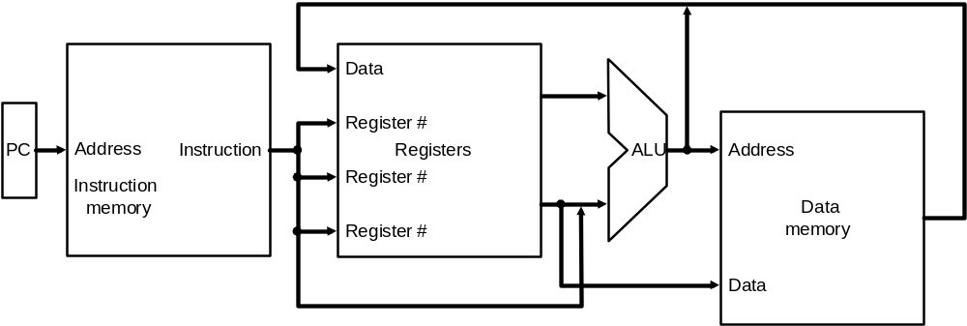
Instruction Processing
5 generic steps (P&H book)
  Instruction fetch (IF)
  Instruction decode and register operand fetch (ID/RF)
  Execute/Evaluate memory address (EX/AG)
  Memory operand fetch (MEM)
  Store/writeback result (WB)
WB
IF
ID/RF
EX/AG
MEM
**Based on original figure from [P&H CO&D, COPYRIGHT 2004 Elsevier. ALL RIGHTS RESERVED.]

Slide 27
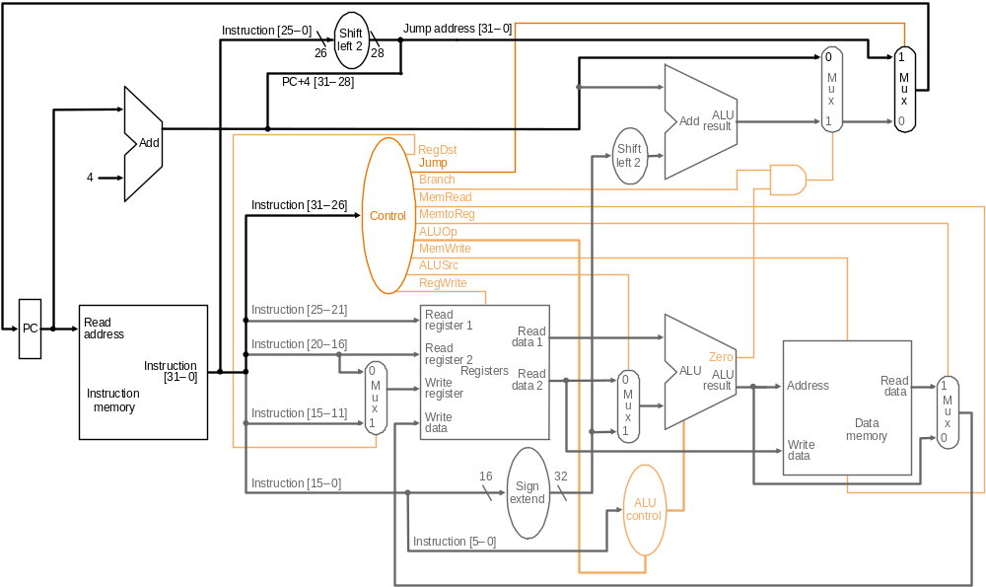
What Is To Come: The Full MIPS Datapath
PCSrc₁=Jump
PCSrc₂=Br Taken
bcond
ALU operation
**Based on original figure from [P&H CO&D, COPYRIGHT 2004 Elsevier. ALL RIGHTS RESERVED.]
JAL, JR, JALR omitted

Slide 28
Single-Cycle Datapath for
Arithmetic and Logical Instructions

Slide 29
R-Type ALU Instructions
Assembly (e.g., register-register signed addition)
ADD rd_{reg} rs_{reg} rt_{reg}
Machine encoding
Semantics
if MEM[PC] == ADD rd rs rt
  GPR[rd] ← GPR[rs] + GPR[rt]
  PC ← PC + 4
0
6-bit
rs
5-bit
rt
5-bit
rd
5-bit
0
5-bit
ADD
6-bit
R-type

Slide 30
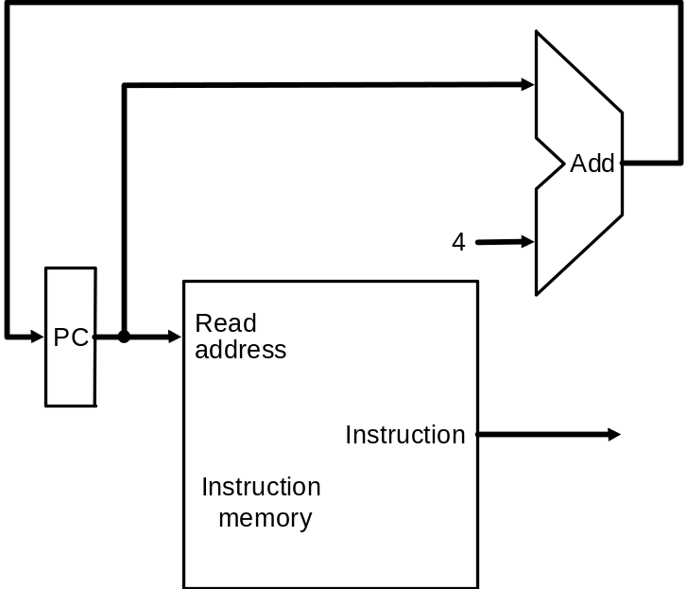
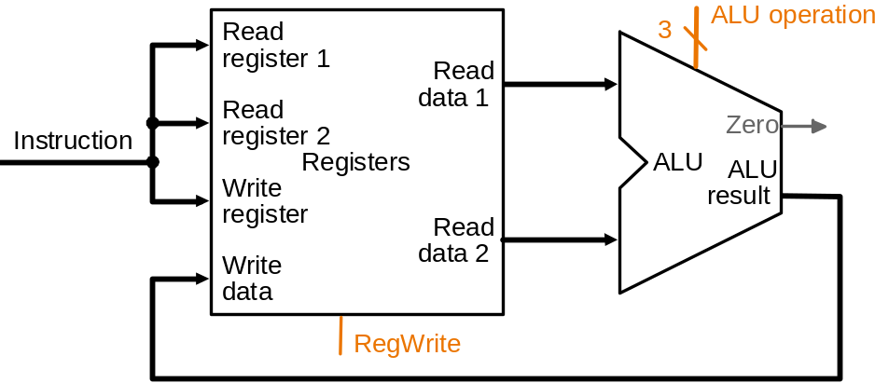
ALU Datapath
25:21
20:16
15:11
1
IF
ID
EX
MEM
WB
if MEM[PC] == ADD rd rs rt
  GPR[rd] ← GPR[rs] + GPR[rt]
  PC ← PC + 4
Combinational
state update logic
**Based on original figure from [P&H CO&D, COPYRIGHT 2004 Elsevier. ALL RIGHTS RESERVED.]
**Based on original figure from [P&H CO&D, COPYRIGHT 2004 Elsevier. ALL RIGHTS RESERVED.]

Slide 31
I-Type ALU Instructions
Assembly (e.g., register-immediate signed additions)
ADDI rt_{reg} rs_{reg} immediate₁₆
Machine encoding
Semantics
if MEM[PC] == ADDI rt rs immediate
GPR[rt] ← GPR[rs] + sign-extend (immediate)
PC ← PC + 4
I-type
ADDI
6-bit
rs
5-bit
rt
5-bit
immediate
16-bit

Slide 32
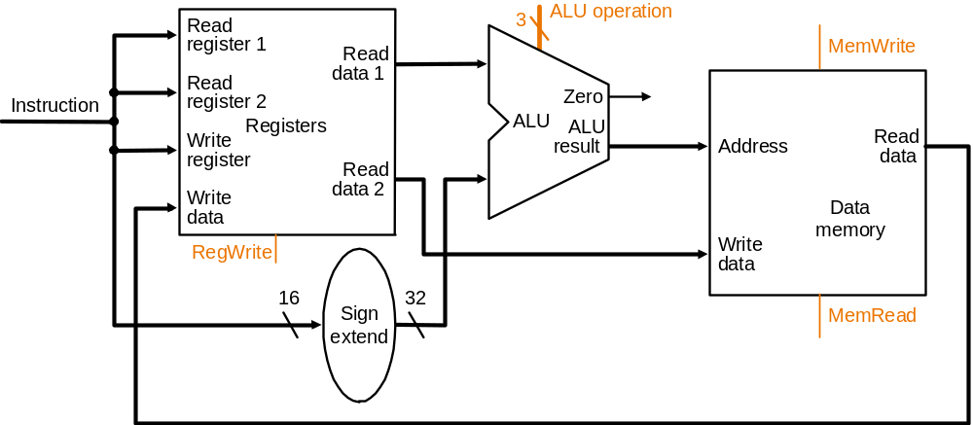
Datapath for R and I-Type ALU Insts.
25:21
20:16
15:11
RegDest
isItype
1
ALUSrc
isItype
IF
ID
EX
MEM
WB
if MEM[PC] == ADDI rt rs immediate
  GPR[rt] ← GPR[rs] + sign-extend (immediate)
  PC ← PC + 4
Combinational
state update logic
**Based on original figure from [P&H CO&D, COPYRIGHT 2004 Elsevier. ALL RIGHTS RESERVED.]

Slide 33
Single-Cycle Datapath for
Data Movement Instructions

Slide 34
Load Instructions
Assembly (e.g., load 4-byte word)
LW rt_{reg} offset₁₆ (base_{reg})
Machine encoding
Semantics
if MEM[PC]==LW rt offset₁₆ (base)
    EA = sign-extend(offset) + GPR[base]
    GPR[rt] ← MEM[ translate(EA) ]
    PC ← PC + 4
LW
6-bit
base
5-bit
rt
5-bit
offset
16-bit
I-type

Slide 35
LW Datapath
0
add
RegDest
isItype
1
ALUSrc
isItype
1
if MEM[PC]==LW rt offset₁₆ (base)
EA = sign-extend(offset) + GPR[base]
GPR[rt] ← MEM[ translate(EA) ]
PC ← PC + 4
IF
ID
EX
MEM
WB
Combinational
state update logic

Slide 36
Store Instructions
Assembly (e.g., store 4-byte word)
SW rt_{reg} offset₁₆ (base_{reg})
Machine encoding
Semantics
if MEM[PC]==SW rt offset₁₆ (base)
    EA = sign-extend(offset) + GPR[base]
    MEM[ translate(EA) ] ← GPR[rt]
    PC ← PC + 4
SW
6-bit
base
5-bit
rt
5-bit
offset
16-bit
I-type

Slide 37
SW Datapath
1
add
RegDest
isItype
0
ALUSrc
isItype
0
if MEM[PC]==SW rt offset₁₆ (base)
EA = sign-extend(offset) + GPR[base]
MEM[ translate(EA) ] ← GPR[rt]
PC ← PC + 4
IF
ID
EX
MEM
WB
Combinational
state update logic

Slide 38
Load-Store Datapath
Pretty like the I-type arithmetic instruction
add
isStore
RegDest
isItype
!isStore
ALUSrc
isItype
isLoad
**Based on original figure from [P&H CO&D, COPYRIGHT 2004 Elsevier. ALL RIGHTS RESERVED.]

Slide 39
Datapath for Non-Control-Flow Insts.
isStore
RegDest
isItype
!isStore
ALUSrc
isItype
isLoad
MemtoReg
isLoad
**Based on original figure from [P&H CO&D, COPYRIGHT 2004 Elsevier. ALL RIGHTS RESERVED.]

Slide 40
Single-Cycle Datapath for
Control Flow Instructions

Slide 41
Unconditional Jump Instructions
Assembly
J immediate₂₆
Machine encoding
Semantics
if MEM[PC]==J immediate₂₆
  target = { PC[31:28], immediate₂₆, 2’b00 }
  PC ← target
J
6-bit
immediate
26-bit
J-type

Slide 42
Unconditional Jump Datapath
isJ
PCSrc
X
0
concat
?
0
ALUSrc
X
0
**Based on original figure from [P&H CO&D, COPYRIGHT 2004 Elsevier. ALL RIGHTS RESERVED.]
if MEM[PC]==J immediate26
PC = { PC[31:28], immediate26, 2’b00 }
What about JR, JAL, JALR?

Slide 43
Aside: MIPS Cheat Sheet
http://www.ece.cmu.edu/~ece447/s15/lib/exe/fetch.php?media=mips_reference_data.pdf
On the 447 website

Slide 44
Conditional Branch Instructions
Assembly (e.g., branch if equal)
BEQ rs_{reg} rt_{reg} immediate₁₆
Machine encoding
Semantics (assuming no branch delay slot)
if MEM[PC]==BEQ rs rt immediate₁₆
    target = PC + 4 + sign-extend(immediate) x 4
    if GPR[rs]==GPR[rt] then PC ← target
    else PC ← PC + 4
BEQ
6-bit
rs
5-bit
rt
5-bit
immediate
16-bit
I-type

Slide 45
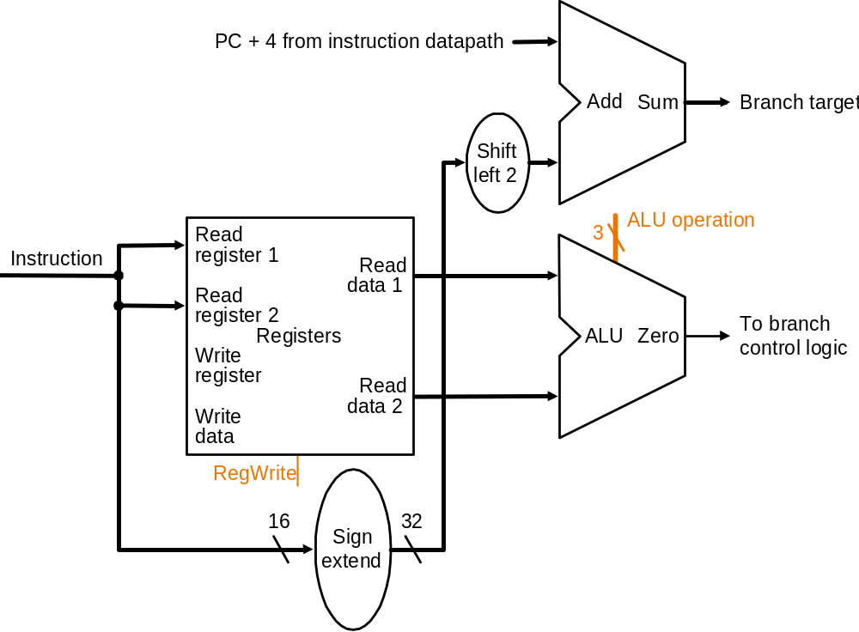
Conditional Branch Datapath (for you to finish)
watch out
PCSrc
sub
concat
bcond
0
**Based on original figure from [P&H CO&D, COPYRIGHT 2004 Elsevier. ALL RIGHTS RESERVED.]
How to uphold the delayed branch semantics?

Slide 46
Putting It All Together
PCSrc₁=Jump
PCSrc₂=Br Taken
bcond
ALU operation
**Based on original figure from [P&H CO&D, COPYRIGHT 2004 Elsevier. ALL RIGHTS RESERVED.]
JAL, JR, JALR omitted

Slide 47
Single-Cycle Control Logic

Slide 48
Single-Cycle Hardwired Control
As combinational function of Inst=MEM[PC]
Consider
  All R-type and I-type ALU instructions
  LW and SW
  BEQ, BNE, BLEZ, BGTZ
  J, JR, JAL, JALR
31
26
21
16
11
6
0
R-type
0
6-bit
rs
5-bit
rt
5-bit
rd
5-bit
shamt
5-bit
funct
6-bit
31
26
21
16
0
I-type
opcode
6-bit
rs
5-bit
rt
5-bit
immediate
16-bit
31
26
0
J-type
opcode
6-bit
immediate
26-bit

Slide 49
Single-Bit Control Signals
 | When De-asserted | When asserted | Equation
RegDest | GPR write select according to rt, i.e., inst[20:16] | GPR write select according to rd, i.e., inst[15:11] | opcode==0
ALUSrc | 2nd ALU input from 2nd GPR read port | 2nd ALU input from sign-extended 16-bit immediate | (opcode!=0) && (opcode!=BEQ) && (opcode!=BNE)
MemtoReg | Steer ALU result to GPR write port | steer memory load to GPR wr. port | opcode==LW
RegWrite | GPR write disabled | GPR write enabled | (opcode!=SW) && (opcode!=Bxx) && (opcode!=J) && (opcode!=JR))
JAL and JALR require additional RegDest and MemtoReg options

Slide 50
Single-Bit Control Signals
 | When De-asserted | When asserted | Equation
MemRead | Memory read disabled | Memory read port return load value | opcode==LW
MemWrite | Memory write disabled | Memory write enabled | opcode==SW
PCSrc₁ | According to PCSrc₂ | next PC is based on 26-bit immediate jump target | (opcode==J) || (opcode==JAL)
PCSrc₂ | next PC = PC + 4 | next PC is based on 16-bit immediate branch target | (opcode==Bxx) && “bcond is satisfied”
JR and JALR require additional PCSrc options

Slide 51
ALU Control
case opcode
  ‘0’ ⇒ select operation according to funct
  ‘ALUi’ ⇒ selection operation according to opcode
  ‘LW’ ⇒ select addition
  ‘SW’ ⇒ select addition
  ‘Bxx’ ⇒ select bcond generation function
  __ ⇒ don’t care
Example ALU operations
  ADD, SUB, AND, OR, XOR, NOR, etc.
  bcond on equal, not equal, LE zero, GT zero, etc.

Slide 52
R-Type ALU
PCSrc₁=Jump
PCSrc₂=Br Taken
1
0
bcond
funct
ALU operation
0
**Based on original figure from [P&H CO&D, COPYRIGHT 2004 Elsevier. ALL RIGHTS RESERVED.]

Slide 53
I-Type ALU
PCSrc₁=Jump
PCSrc₂=Br Taken
1
0
bcond
opcode
ALU operation
0
**Based on original figure from [P&H CO&D, COPYRIGHT 2004 Elsevier. ALL RIGHTS RESERVED.]

Slide 54
LW
PCSrc₁=Jump
PCSrc₂=Br Taken
1
0
bcond
Add
ALU operation
1
**Based on original figure from [P&H CO&D, COPYRIGHT 2004 Elsevier. ALL RIGHTS RESERVED.]

Slide 55
SW
PCSrc₁=Jump
PCSrc₂=Br Taken
0
1
bcond
X
X
Add
ALU operation
0
**Based on original figure from [P&H CO&D, COPYRIGHT 2004 Elsevier. ALL RIGHTS RESERVED.]

Slide 56
Branch (Not Taken)
Some control signals are dependent
on the processing of data
PCSrc₁=Jump
PCSrc₂=Br Taken
0
0
bcond
X
X
bcond
ALU operation
0
**Based on original figure from [P&H CO&D, COPYRIGHT 2004 Elsevier. ALL RIGHTS RESERVED.]

Slide 57
Branch (Taken)
Some control signals are dependent
on the processing of data
PCSrc₁=Jump
PCSrc₂=Br Taken
0
0
bcond
X
X
bcond
ALU operation
0
**Based on original figure from [P&H CO&D, COPYRIGHT 2004 Elsevier. ALL RIGHTS RESERVED.]

Slide 58
Jump
PCSrc₁=Jump
X
PCSrc₂=Br Taken
0
0
bcond
X
X
X
X
ALU operation
0
**Based on original figure from [P&H CO&D, COPYRIGHT 2004 Elsevier. ALL RIGHTS RESERVED.]

Slide 59
What is in That Control Box?
Combinational Logic → Hardwired Control
  Idea: Control signals generated combinationally based on instruction
  Necessary in a single-cycle microarchitecture…
Sequential Logic → Sequential/Microprogrammed Control
  Idea: A memory structure contains the control signals associated with an instruction
  Control Store

Slide 60
Evaluating the Single-Cycle Microarchitecture

Slide 61
A Single-Cycle Microarchitecture
Is this a good idea/design?
When is this a good design?
When is this a bad design?
How can we design a better microarchitecture?

Slide 62
A Single-Cycle Microarchitecture: Analysis
Every instruction takes 1 cycle to execute
  CPI (Cycles per instruction) is strictly 1
How long each instruction takes is determined by how long the slowest instruction takes to execute
  Even though many instructions do not need that long to execute
Clock cycle time of the microarchitecture is determined by how long it takes to complete the slowest instruction
  Critical path of the design is determined by the processing time of the slowest instruction

Slide 63
What is the Slowest Instruction to Process?
  Let’s go back to the basics
  All six phases of the instruction processing cycle take a single machine clock cycle to complete
  Fetch
  Decode
  Evaluate Address
  Fetch Operands
  Execute
  Store Result
Do each of the above phases take the same time (latency) for all instructions?
  1. Instruction fetch (IF)
  2. Instruction decode and
  register operand fetch (ID/RF)
  3. Execute/Evaluate memory address (EX/AG)
  4. Memory operand fetch (MEM)
  5. Store/writeback result (WB)

Slide 64
Single-Cycle Datapath Analysis
Assume
  memory units (read or write): 200 ps
  ALU and adders: 100 ps
  register file (read or write): 50 ps
  other combinational logic: 0 ps
steps | IF | ID | EX | MEM | WB | Delay
resources | mem | RF | ALU | mem | RF
R-type | 200 | 50 | 100 |  | 50 | 400
I-type | 200 | 50 | 100 |  | 50 | 400
LW | 200 | 50 | 100 | 200 | 50 | 600
SW | 200 | 50 | 100 | 200 |  | 550
Branch | 200 | 50 | 100 |  |  | 350
Jump | 200 |  |  |  |  | 200

Slide 65
Let’s Find the Critical Path
PCSrc₁=Jump
PCSrc₂=Br Taken
bcond
ALU operation
[Based on original figure from P&H CO&D, COPYRIGHT 2004 Elsevier. ALL RIGHTS RESERVED.]

Slide 66
R-Type and I-Type ALU
Only registers, do not need to access memory when do calculation
PCSrc₁=Jump
100ps ALU
PCSrc₂=Br Taken
100ps
200ps MEM
250ps REG
bcond
400ps REG
350ps ALU
ALU operation
[Based on original figure from P&H CO&D, COPYRIGHT 2004 Elsevier. ALL RIGHTS RESERVED.]

Slide 67
LW
PCSrc₁=Jump
100ps
PCSrc₂=Br Taken
100ps
200ps
250ps
bcond
550ps MEM
600ps
350ps
ALU operation
[Based on original figure from P&H CO&D, COPYRIGHT 2004 Elsevier. ALL RIGHTS RESERVED.]

Slide 68
SW
PCSrc₁=Jump
100ps
PCSrc₂=Br Taken
100ps
200ps
250ps
bcond
350ps
550ps MEM
ALU operation
[Based on original figure from P&H CO&D, COPYRIGHT 2004 Elsevier. ALL RIGHTS RESERVED.]

Slide 69
Branch Taken
PCSrc₁=Jump
200ps
100ps
PCSrc₂=Br Taken
350ps
350ps ALU
200ps
250ps
bcond
ALU operation
[Based on original figure from P&H CO&D, COPYRIGHT 2004 Elsevier. ALL RIGHTS RESERVED.]

Slide 70
Jump
PCSrc₁=Jump
100ps
PCSrc₂=Br Taken
200ps
200ps MEM
bcond
ALU operation
[Based on original figure from P&H CO&D, COPYRIGHT 2004 Elsevier. ALL RIGHTS RESERVED.]

Slide 71
What About Control Logic?
Like bcond
How does that affect the critical path?
Food for thought for you:
  Can control logic be on the critical path?
  A note on CDC 5600: control store access too long…

Slide 72
What is the Slowest Instruction to Process?
Memory is not magic
What if memory sometimes takes 100ms to access?
Does it make sense to have a simple register to register add or jump to take {100ms+all else to do a memory operation}?
And, what if you need to access memory more than once to process an instruction?
  Which instructions need this?
  Do you provide multiple ports to memory?

Slide 73
Single Cycle uArch: Complexity
Contrived
  All instructions run as slow as the slowest instruction
Inefficient
  All instructions run as slow as the slowest instruction
  Must provide worst-case combinational resources in parallel as required by any instruction
  Need to replicate a resource if it is needed more than once by an instruction during different parts of the instruction processing cycle
Not necessarily the simplest way to implement an ISA
  Single-cycle implementation of REP MOVS (x86) or INDEX (VAX)?
Not easy to optimize/improve performance
  Optimizing the common case does not work (e.g. common instructions)
  Need to optimize the worst case all the time

Slide 74
(Micro)architecture Design Principles
Critical path design
  Find and decrease the maximum combinational logic delay
  Break a path into multiple cycles if it takes too long
Bread and butter (common case) design
  Spend time and resources on where it matters most
    i.e., improve what the machine is really designed to do
  Common case vs. uncommon case
Balanced design
  Balance instruction/data flow through hardware components
  Design to eliminate bottlenecks: balance the hardware for the work

Slide 75
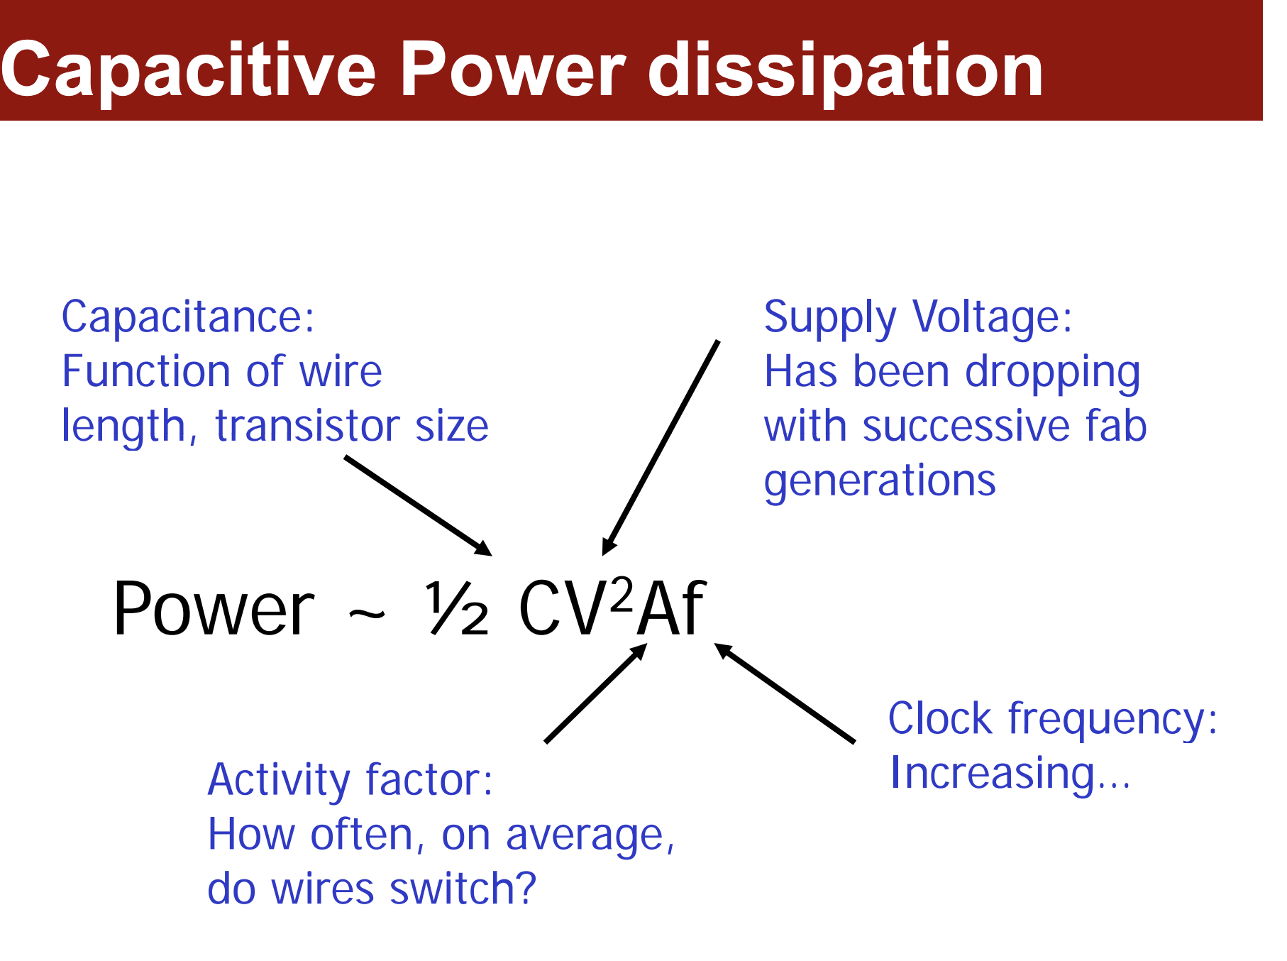
If you want to increase your frequency, you may also need to increase the voltage

Slide 76
Single-Cycle Design vs. Design Principles
Critical path design
  Find the maximum combinational logic delay and increase it
Bread and butter (common case) design
  Spend time and resources on where it matters
    i.e., improve what the machine is really designed to do
  Common case vs. uncommon case
    i.e., if you execute add most of the time
Balanced design
  Balance instruction/data flow through hardware components
  Balance the hardware needed to accomplish the work
How does a single-cycle microarchitecture fare in light of these principles?

Slide 77
Aside: System Design Principles
When designing computer systems/architectures, it is important to follow good principles
Remember: “principled design” from our first lecture
  Frank Lloyd Wright: “architecture […] based upon principle, and not upon precedent”

Slide 78


Aside: From Lecture 1
“architecture […] based upon principle, and not upon precedent”

Slide 79
Aside: System Design Principles
We will continue to cover key principles in this course
Here are some references where you can learn more
Yale Patt, “Requirements, Bottlenecks, and Good Fortune: Agents for Microprocessor Evolution,” Proc. of IEEE, 2001. (Levels of transformation, design point, etc)
Mike Flynn, “Very High-Speed Computing Systems,” Proc. of IEEE, 1966. (Flynn’s Bottleneck → Balanced design)
Gene M. Amdahl, "Validity of the single processor approach to achieving large scale computing capabilities," AFIPS Conference, April 1967. (Amdahl’s Law → Common-case design)
Butler W. Lampson, “Hints for Computer System Design,” ACM Operating Systems Review, 1983.
  http://research.microsoft.com/pubs/68221/acrobat.pdf

Slide 80
Aside: One Important Principle
Keep it simple
“Everything should be made as simple as possible, but no simpler.”
  Albert Einstein
And, do not forget: “An engineer is a person who can do for a dime what any fool can do for a dollar.”
For more, see:
  Butler W. Lampson, “Hints for Computer System Design,” ACM Operating Systems Review, 1983.
  http://research.microsoft.com/pubs/68221/acrobat.pdf

Slide 81
Multi-Cycle Microarchitectures

